Slide 1






SECTION 1: PROJECT OVERVIEW & MANAGEMENT
UK-Train-Rides
Analysis Project
Group Code: YAT525A...
Mazen Ezzat
Ali Mohamed
Mohammed Al-Saeed
Abdelrahman Ahmed
Ahmed
Sheta

Slide 2

Project Proposal & Objectives
Objective
•
Operational analysis of a real railway network studying 31,000+ actual transactions.
•
Uncover booking patterns, evaluate trip performance, and identify operational challenges (delays, refunds).
•
Understand passenger purchasing and payment behaviors.
•
Utilize Python and Power BI for integrated vision and improvement opportunities.

Slide 3
Project Proposal & Objectives
Scope
Operational Overview: Analyzing high-level metrics such as Total Sold Tickets, Total Journeys, and the overall status of trips (On-Time, Delayed, Cancelled).
Executive Performance (Revenue Analysis): Tracking financial performance, including Total Revenue vs. Net Revenue, identifying top revenue-generating routes and departure stations, and analyzing payment methods
.Delay Analysis: Investigating the root causes of delays (e.g., Weather, Signal Failure, Staff Shortage), their seasonality (month-over-month trends), and identifying which routes are most affected by specific delay reasons.
Refunds & Cancellations: Monitoring Cancellation Rates and Refund Values, analyzing the impact of ticket classes (Standard vs. First Class) on refunds, and tracking revenue loss due to disruptions.

Slide 4





Project Plan & Timeline
WEEK 2
WEEK 3
WEEK 4
WEEK 5
WEEK 6
Phase 1
Phase 2
Phase 3
Phase 4
Phase 5
Data Cleaning & Transformation
Data Analysis & Metric Creation
Dashboard Development
Review & Refinement
Presentation & Documentation
Handle missing values, fix inconsistencies, prepare dataset using Python (Pandas).
Analyze patterns of delays, refunds, payments, and trip efficiency.
Build Power BI dashboard with interactive visuals and KPIs.
Validate results, enhance visuals, optimize performance.
Prepare presentation, reports, upload to GitHub.
Milestone: Project completed.
Milestone: Key insights identified.
Milestone: First version of dashboard.
Milestone: Final dashboard ready.
Milestone: Cleaned dataset ready.

Slide 5
Resources & Task Assignment
Task Assignment & Roles
Resources
Data Cleaning & Transformation | [Mazen Ezzat]
Data Analysis & Metrics Creation | [Mazen Ezzat]
Dashboard Development | [Ali Mohammed ]
Review & Refinement | [Mohammed Al-Saeed ]
Presentation & Documentation | [Abdelrahman Ahmed]
Tools: Python, Power BI.
Libraries: Pandas, Matplotlib, Seaborn (visualization).
Data Source: DEPI Datasets (UK Train Rides dataset).

Slide 6





Risk Assessment & Mitigation
Risk 1
Risk 2
Risk 3
Missing or inconsistent data.
Performance issues in Power BI.
Misinterpretation of insights.
Solution: Use Python validation and data cleaning scripts.
Solution: Optimize data model and use DAX efficiently.
Solution: Validate results with domain experts or supervisors.

Slide 7

Section 2: System Analysis & Design

Slide 8

Requirements Gathering
Stakeholder Analysis
User Stories
•
Business Managers: Interested in operational efficiency and revenue.
"As an operations manager, I want to monitor train delays to identify problematic routes."
"As a financial analyst, I want to track refund trends to reduce operational losses."
•
Transport Authorities: Need punctuality and delay reports.
•
Passengers: Indirect beneficiaries through improved service.

Slide 9
Functional & Non-Functional Requirements
Functional Requirements
Non-Functional Requirements
▪
Dashboard showing KPIs (delays, refunds, sales, booking volume).
○
Dashboard loads within 5 seconds.
○
Clean and accessible visualization style.
▪
Filters by date, route, station, and payment method.
○
Scalable data model to handle future datasets.
▪
Interactive visuals (maps, charts, drill-down reports).

Slide 10

System Architecture & Data Flow
Problem Statement: Manual analysis consumes time and misses patterns. Automation supports better decision-making.
Software Architecture
Data Flow (DFD)
•
Data Source: CSV files from DEPI datasets.
1.
Extract data from DEPI dataset.
•
Backend Processing: Python (Data cleaning/transformation).
2.
Transform using Python scripts.
3.
Load into Power BI.
•
Visualization Layer: Power BI dashboard.
4.
Generate and analyze KPIs.

Slide 11
Dataset Overview (Columns)
Key Columns
Key KPIs
•
Transaction ID, Trip ID, Customer ID.
Total number of trips.
•
Departure/Arrival Time, Delay (minutes).
Average delay time per route.
•
Refund Request, Payment Method, Ticket Price.
Total refund requests & Refund Rate.
•
Route, Station From, Station To.
On-time performance ratio.
•
Date of Travel, Booking Date.

Slide 12
Database Schema (Logical & Physical)
Logical Schema
Dimension Tables
DimTicket: Ticket Class, Ticket Type.
DimPaymentMethod: Payment Method.
DimRailcard: Railcard.
DimJourneyStatus: Journey Status.
DimPurchaseType: Purchase Type.
DimStation: Arrival Destination, Dep_DES_ID.
DimDelay: Delay_ID.
DimTime: Actual Arrival Time, Arrival Time, Departure Time, Time of Purchase.
3. Date Table
Calendar: Date, Month, Month-Year, MonthNum, Quarter.
4. Measures Table
Measures:
  Average Refund Value
  Average Ticket Price
  Cancellation Rate %
  Cancelled Journeys
. Fact Table
Fact_Data:
  Date of Journey
  Date of Purchase
  Foreign Keys: (Delay_ID, JourneyStatus_ID, PaymentMethod_ID, PurchaseType_ID, Railcard_ID, Dep_DES_ID, Ticket_ID)

Slide 13
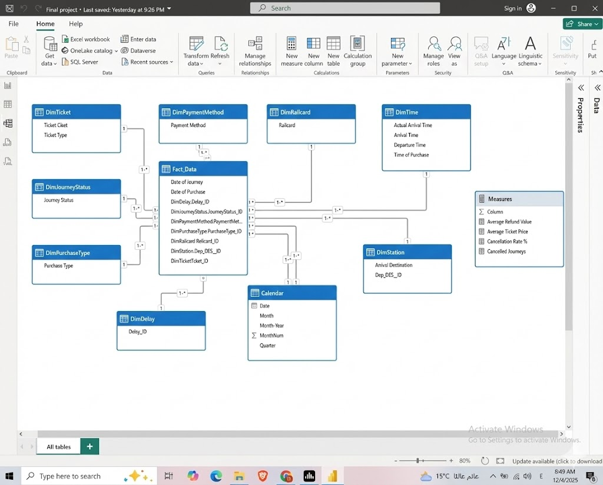
Database Schema (Logical & Physical)

Slide 14
Section 3: Technical Implementation

Slide 15

Python Analysis Workflow (Overview)
Scope: End-to-end data analysis pipeline.
"This project uses a complete Python pipeline to turn raw railway transactions into visual insights."
Main Areas: Data ingestion, cleaning, feature engineering, visualization, export.
Output: Charts + cleaned CSV.

Slide 16
Setup & Loading
Description: Setting up the analytical environment and importing the raw dataset to begin the project.
Techniques Used (Code Logic):
Import Libraries: Importing Pandas (for data manipulation), NumPy (for calculations), Matplotlib & Seaborn (for visualization).
Data Loading: Using pd.read_csv() to ingest the dataset.
Exploratory Data Analysis (EDA): Using df.info(), df.describe(), and df.isnull().sum() to understand the data structure and quality.

Slide 17
Data Cleaning
Description: The most critical phase to ensure accuracy by fixing errors and formatting data for analysis.
Techniques Used (Code Logic):
Text Cleaning: Removing extra whitespace using .str.strip() to ensure consistency.
Handling Duplicates: Removing duplicate entries using drop_duplicates().
Date Conversion: Converting string columns to datetime objects using pd.to_datetime() to enable time-series analysis.
Missing Values Treatment: Imputing null values using fillna() (e.g., filling missing delay reasons with "No Delay").
Standardization: Unifying terminology (e.g., renaming "Signal failure" to "Signal Failure") using .replace().
Feature Engineering: Creating a new Routes column by combining Departure and Arrival stations to facilitate route analysis.

Slide 18





Visualization Setup & Analysis Scopes
Directories: save_path = "D:/Railway_Charts" (os.makedirs).
Settings: sns.set_style("whitegrid"). Custom palette for consistent branding (blue tones).
Sales Scope
Customer Scope
Operation Scope
Revenue (Net/Gross), Price by ticket class, Railcard impact.
Payment methods, Railcard usage, Refund requests by payment channel.
Journey status, Delay reasons, Peak delay times, Cancellation rates.

Slide 19
Sales Scope Analysis
Description: Analyzing financial performance and identifying key revenue drivers.
Techniques Used (Code Logic):
KPI Calculation: Calculating Total Revenue (.sum()) and Average Ticket Price (.mean()).
Categorical Analysis: Analyzing prices based on Ticket Class and Ticket Type using Bar Charts.
Top Performers: Identifying the "Top 10 Routes by Revenue" using .groupby() and .sort_values().
Time Series: Tracking revenue trends over time using Line Plots.

Slide 20
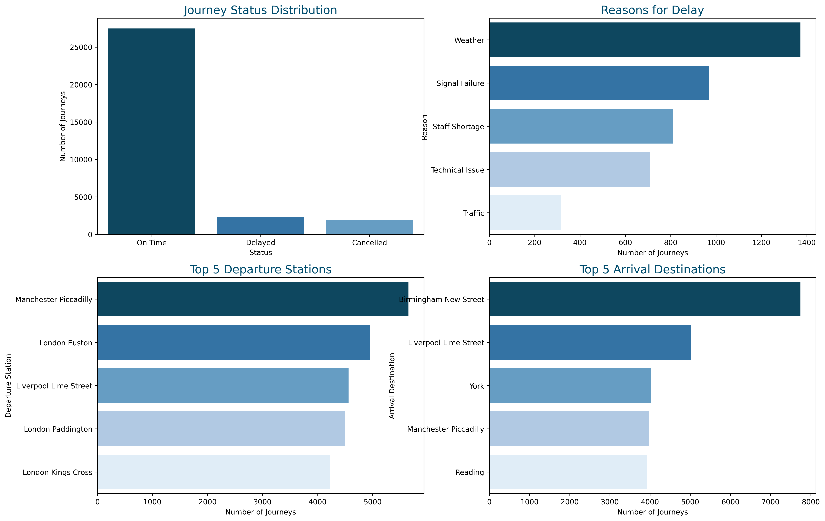
Sales Scope Analysis

Slide 21
Customer Scope Analysis
Description: Analyzing financial performance and identifying key revenue drivers.
Techniques Used (Code Logic):
KPI Calculation: Calculating Total Revenue (.sum()) and Average Ticket Price (.mean()).
Categorical Analysis: Analyzing prices based on Ticket Class and Ticket Type using Bar Charts.
Top Performers: Identifying the "Top 10 Routes by Revenue" using .groupby() and .sort_values().
Time Series: Tracking revenue trends over time using Line Plots.

Slide 22
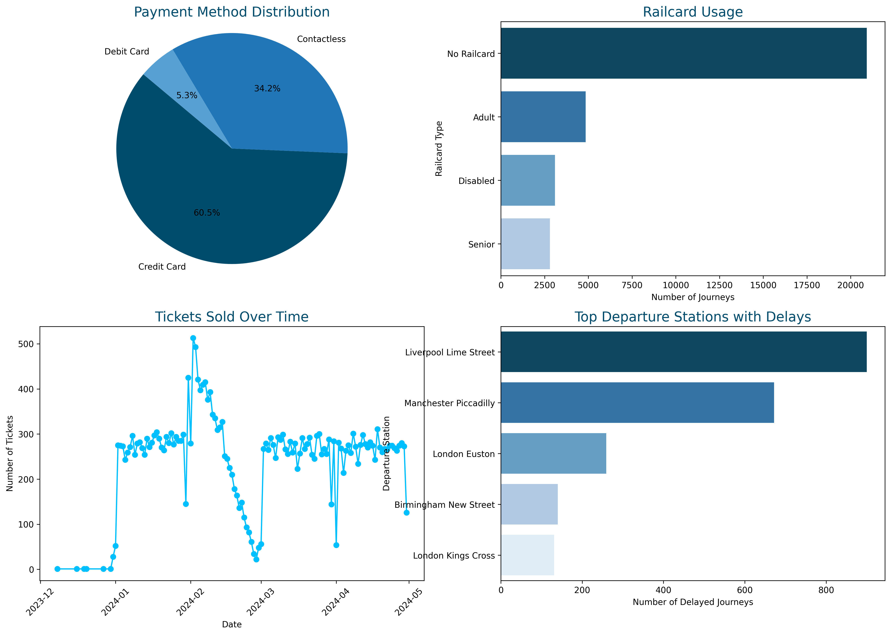
Customer Scope Analysis

Slide 23
Operation Scope Analysis
Description: Analyzing financial performance and identifying key revenue drivers.
Techniques Used (Code Logic):
KPI Calculation: Calculating Total Revenue (.sum()) and Average Ticket Price (.mean()).
Categorical Analysis: Analyzing prices based on Ticket Class and Ticket Type using Bar Charts.
Top Performers: Identifying the "Top 10 Routes by Revenue" using .groupby() and .sort_values().
Time Series: Tracking revenue trends over time using Line Plots.

Slide 24
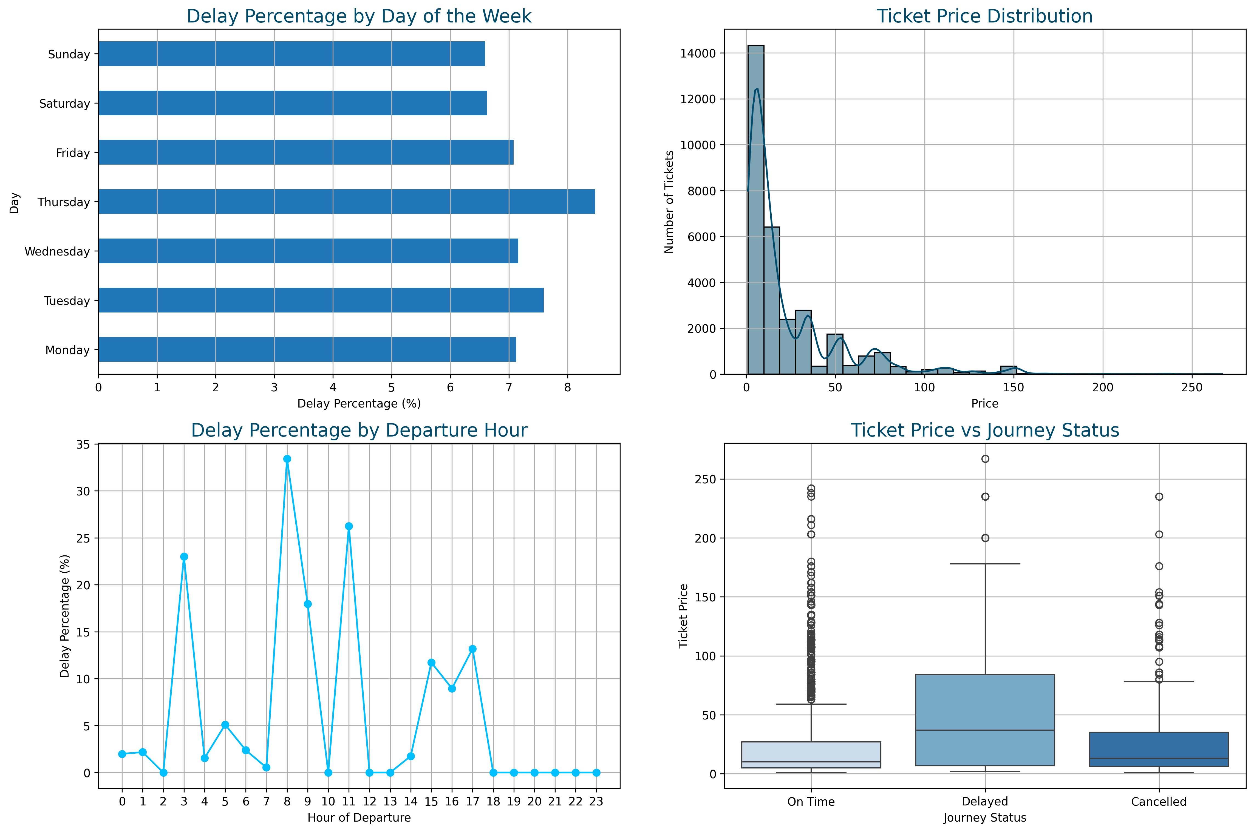
Operation Scope Analysis

Slide 25
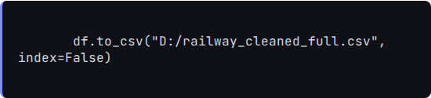
Export & Summary
Export
Summary
•
Inputs: Raw CSV.
•
Process: EDA → Cleaning → Engineering → Viz.
•
Value: Revenue trends, delay causes, operational hotspots.
Purpose: Source for Power BI and reproducibility.

Slide 26
Section 4: Data Modeling for Power BI

Slide 27
Data Model Structure (Star Schema)
1. Fact Table (Fact_Data)
2. Dimension Tables (Dims)
Role: Central table containing quantitative data (transactions).
Surround the Fact table (One-to-Many).
Tables: DimStation (Details), DimTime, DimTicket (Class/Type), DimPaymentMethod, DimRailcard, DimJourneyStatus, DimPurchaseType, DimDelay (Reasons), Calendar.
Contents: Date of Journey, Purchase, Foreign Keys (DimDelay.Delay_ID, etc.).

Slide 28
Special Tables & Interactions
4. How They Work Together
3. Measures Table
•
Fact_Data in the center (Many side).
Container for DAX calculations.
•
Dimensions surrounding (One side).
Examples: Average Ticket Price, Cancellation Rate %.
•
Allows filtering millions of records by attributes like Station Name or Month.

Slide 29
Dashboard Intro Page
Purpose: Navigation hub and project cover.
Project Identity: Group Code (YAT525A...), Members List.
Navigation Bar:
•
Operational Overview
•
Executive Performance
•
Delays Reason
•
Refunds

Slide 30
Operational Overview
Focus: General health of railway operations.
Top KPIs:
•
Total Sold Tickets: 32K
•
Net Revenue: 703K
•
Cancelled Journeys: 1880
Charts:
•
Revenue Over Time (Line): Jan–Apr 2024.
•
Total Journeys by Status (Column).
•
Payment Method: Credit Card 60.46%.

Slide 31
Executive Performance
Purpose: Stakeholders’ view on profitability & high-level stats.
Top KPIs:
•
Refunded Journeys: 1,118
•
Refund Value: 39K
Charts:
•
Revenue by Departure Station (London Kings Cross highest).
•
Journey Status: On Time 86.82%.
•
Transaction by Railcard: 66.09% No Railcard.

Slide 32
Delays Reason
Purpose: Analyze the 7.24% of delayed journeys.
Top KPIs:
•
OnTime %: 86.82%
•
Delayed Journeys %: 7.24%
Charts:
•
Delayed by Reason: Weather top, then Technical.
•
Delayed by Month: Peak in March.
•
Top Delayed Routes: Liverpool Lime St worst.

Slide 33
Refunds & Cancellations
Purpose: Analyze critical failures when trains don’t run.
Top KPIs:
•
Cancellation Rate: 5.94%
•
Refund Rate: 3.53%
Charts:
•
Cancellation Rate % by Route.
•
Refund Value by Class: Standard Class 83.56%.
•
Cancelled Reasons: Signal Failure main.

Slide 34



Deployment & Integration
Deployment Diagram
Technology Stack
•
Python (Pandas, Matplotlib)
•
Power BI
Connection between Power BI visuals and Python-prepared dataset.

Slide 35
Deliverables & Next Steps
Final Deliverables
Optional Next Steps
Cleaned Dataset (CSV).
•
Add automated notebooks / scheduled ETL.
Interactive Power BI Dashboard.
•
Build advanced DAX measures in Measures table.
Python Analysis Scripts & PNG Charts.
Project Documentation.
•
Add predictive models for delay forecasting.

Slide 36
Thank You
Q&A
UK-Train-Rides Analysis Project

